Slide 1




SMART INDIA HACKATHON 2026
  Problem Statement ID - SIH26095
  Problem Statement Title- Smart Real-Time Monitoring & Inspection Mobile App (MoSJE)
  Theme- Smart Automation
  PS Category- Software
  Team ID-
  Team Name (Registered on portal) - Lumora

Slide 2

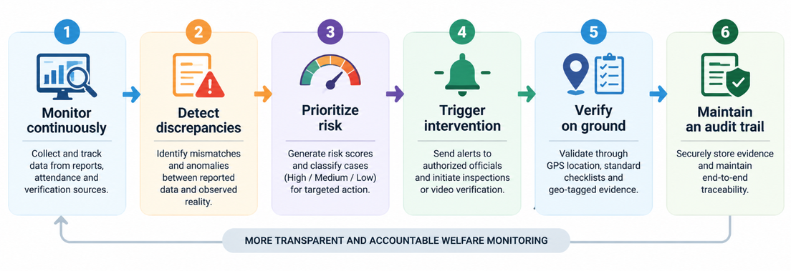
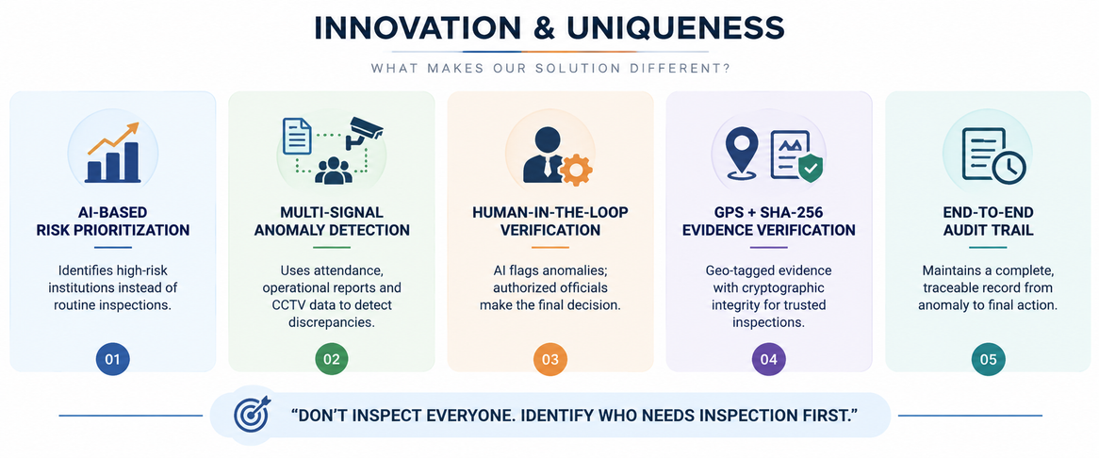
Lumora
PROPOSED SOLUTION
HOW IT WORKS
AI-Powered Risk-Based Monitoring & Verification of Welfare Institutions
  NIRIKSHAN AI is a unified, intelligent monitoring platform that integrates institutional reporting, CCTV-based telemetry, anomaly detection, risk assessment, official intervention, field verification, and beneficiary feedback into a single transparent and auditable workflow.
  It enables authorities to identify risks early, prioritize high-risk institutions, verify ground-level conditions, and take timely corrective action while maintaining complete evidence and audit trails.
INNOVATION AND UNIQUENESS
@SIH Idea submission
2
Notes:
2

Slide 3
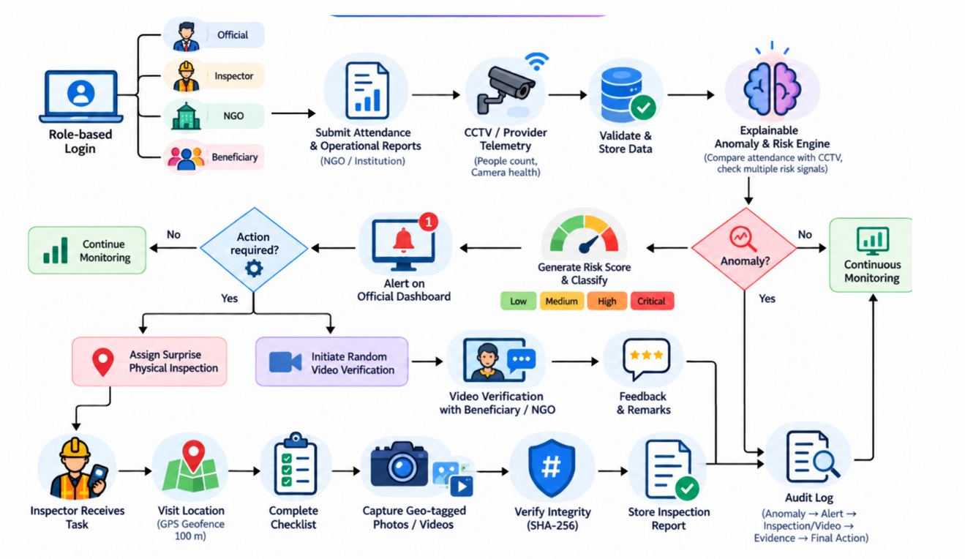
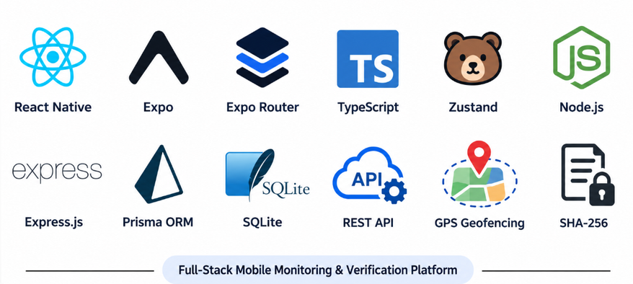
TECHNICAL APPROACH
IDEA/APPROACH
TECH STACK USED
TECHNICAL APPROACH
  Data → Process → Detect → Act → Verify → Audit
  Data: Attendance, reports & CCTV telemetry
  Process: Validate, compare & store data
  Detect: Anomaly detection + risk scoring
  Act: Alerts & surprise inspections
  Verify: GPS, checklist & geo-tagged evidence
  Audit: SHA-256 integrity + complete audit trail
@SIH Idea submission
3
Notes:
3

Slide 4
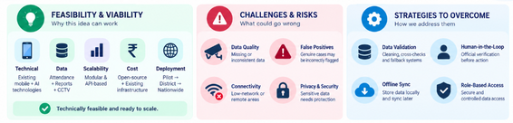
FEASIBILITY AND VIABILITY
FEASIBILITY
VIABILITY
  Technically feasible using a mobile + backend architecture.
  Scalable through modular APIs and replaceable CCTV/data providers.
  Practical with GPS, digital checklists and geo-tagged evidence.
  Cost-effective by using existing infrastructure and software technologies.
  Deployable across NGOs, institutes, hostels and welfare projects.
  Built using widely available and open-source technologies, keeping development and deployment costs low.
  Designed as a modular platform, allowing CCTV, attendance, inspection, AI analytics, and beneficiary feedback to be integrated progressively.
  Supports mobile-based and offline-capable inspections, making it practical for field teams operating in areas with limited connectivity.
  Can integrate with existing CCTV infrastructure and institutional systems, reducing the need for complete infrastructure replacement.
  Uses automated risk scoring and inspection assignment to handle large numbers of institutions without requiring proportional increases in manpower.
  Maintains secure, auditable digital records through role-based access, geo-tagging, timestamps, and SHA-256 evidence integrity, making the system suitable for government-level adoption.
  Human-in-the-loop AI → Officials verify alerts before action.
  Offline-ready design → Store inspection data locally and sync when online.
  Privacy & access control → Use role-based access and secure data handling.
  Modular architecture → Easily integrate new institutions and authorized data sources.
@SIH Idea submission
4
Notes:
4

Slide 5
IMPACT AND BENEFITS
Your Team Name
IMPACT
KEY BENEFITS
  Government: Gets a centralized view of institutions, real-time alerts, and risk insights to take timely corrective action.
  Inspectors: Receive prioritized assignments and use verified, geo-tagged evidence to conduct more accurate and efficient inspections.
  NGOs: Benefit from transparent reporting, simplified compliance processes, and clear records of their performance.
  Beneficiaries: Receive better-verified services, with faster identification of service gaps and issues affecting their welfare.
  Enables continuous monitoring of welfare institutions instead of relying only on periodic physical inspections.
  Detects discrepancies and suspicious patterns early by cross-verifying reports, attendance, CCTV data, and field evidence.
  Ensures inspections are genuine and verifiable through GPS-based location validation, time-stamped evidence, and SHA-256 integrity checks.
  Helps officials prioritize high-risk institutions and allocate limited inspection teams where intervention is most needed.
  Creates a transparent, centralized audit trail that improves accountability and ensures welfare services actually reach the intended beneficiaries.
  Reduces manual paperwork and administrative workload by digitizing inspections, evidence collection, and report submission.
  Enables faster decision-making through real-time alerts, centralized dashboards, and automated risk-based prioritization.
@SIH Idea submission
5
Notes:
5

Slide 6
RESEARCH AND REFERENCES
Your Team Name
EXISTING SOLUTIONS
  PIB – PM-AJAY Portal & AJAY App Launch (MoSJE):https://www.pib.gov.in/PressReleasePage.aspx?PRID=2265530
  GIA Inspection App (MoSJE):https://play.google.com/store/apps/details?id=com.irform
  DGT ITI Inspection 2.0 App:https://play.google.com/store/apps/details?id=com.iti.itiaffililation
  Nature – Crowd Anomaly Detection in Surveillance:https://www.nature.com/articles/s41598-025-27408-9
  SafetyCulture – Inspection Platform:https://safetyculture.com/
  Digital India Programme:https://www.digitalindia.gov.in/
@SIH Idea submission
6
Notes:
6

